Slide 1
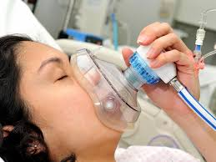
Nitrous oxide (Entenox) and the risks to midwives?
Wendy Jones PhD MBE
Pharmacist

Slide 2
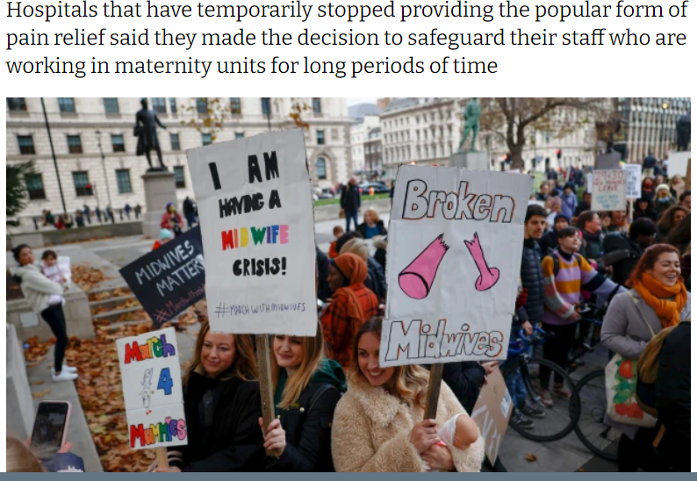
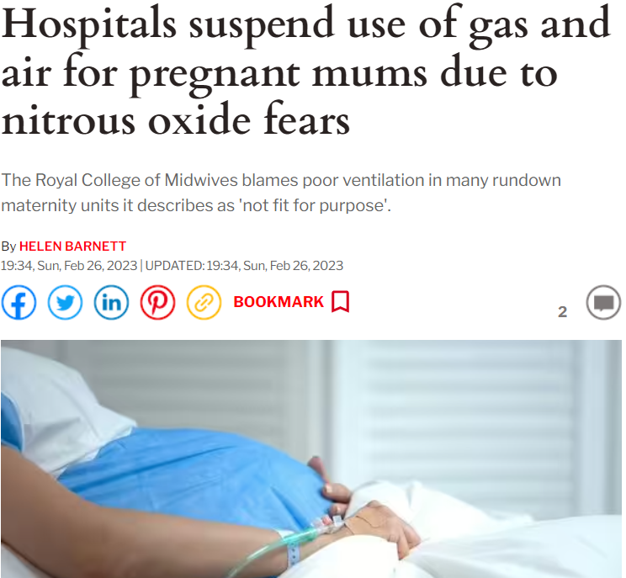
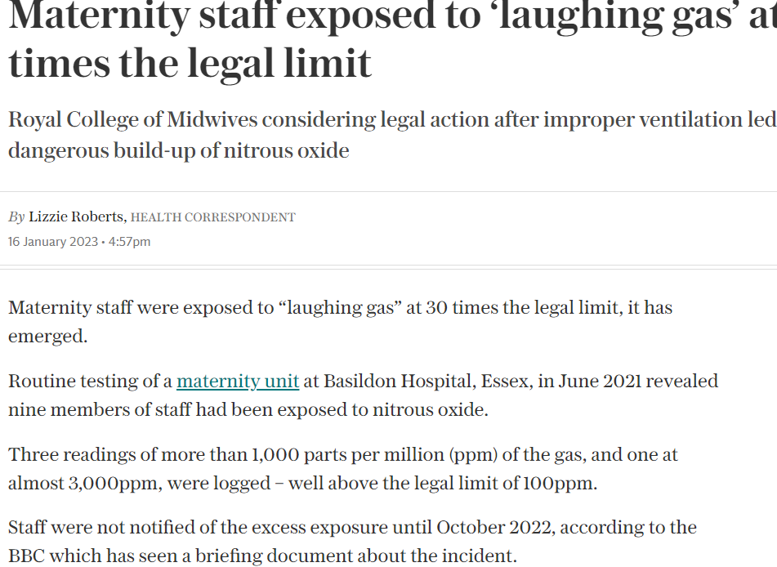
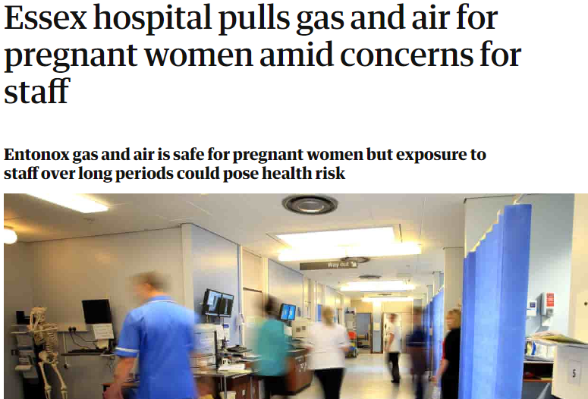
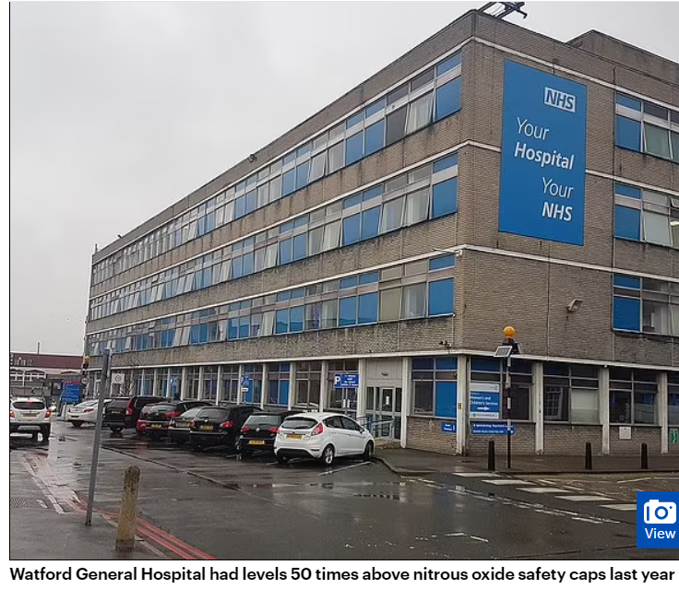
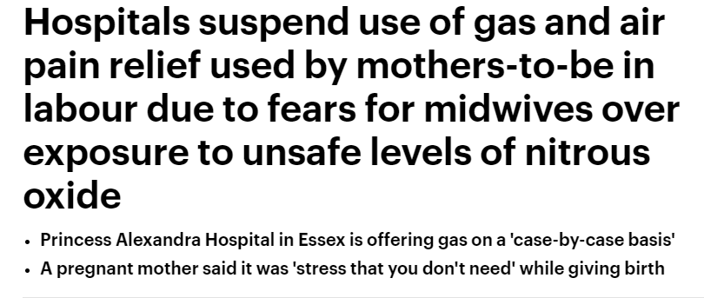

Slide 3
Environmental impact
Anaesthetic gases make up 5% of the carbon footprint for acute hospitals, with nitrous oxide and desflurane being the greatest culprits for negative climate effect
Nitrous oxide has a negative environmental impact resulting in destruction to the ozone layer, with 1kg of nitrous oxide having the same effect as 298kg of carbon dioxide
https://www.britishjournalofmidwifery.com/content/research/sustainability-of-entonox-in-obstetrics-a-qualitative-study/
Ek M, Tjus K. Destruction of medical N2O in Sweden. In: Liu G (ed). London: IntechOpen; 2012
Charlesworth M, Swinton F. Anaesthetic gases, climate change, and sustainable practice. Lancet Planet Health. 2017; 1:e216-e217

Slide 4
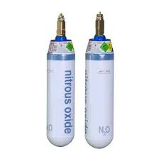
Waste
King’s College Hospital found that found that most of the waste comes from the piped manifold systems
only ~8% of what is purchased from suppliers is actually utilised clinically, meaning up to 92% of the nitrous oxide is wasted
Local cylinders, would drastically reduce wastage.
Entonox leaks out into clinical areas if any seals have deteriorated; the demand valves are left attached when not in use; or if the system is not appropriately maintained.
https://pharmaceutical-journal.com/article/opinion/nitrous-oxide-could-be-harming-people-as-much-as-the-planet

Slide 5
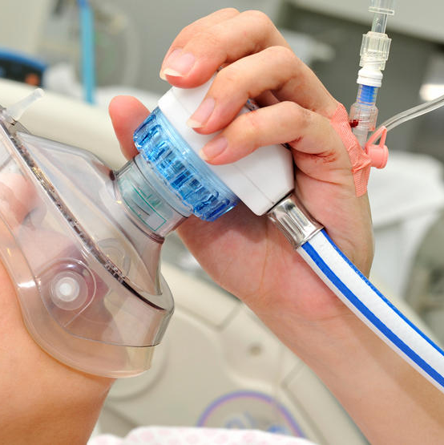
Entonox in labour
Entonox offers labouring women something to focus on, acting as an anxiolytic throughout their labour
It aligns with some labouring women's birth plan, reduces the need for epidural analgesia and women often consider it part of a ‘natural birth’
It provides some pain relief for a labouring woman is readily available for use and can be initiated without delay, allowing for both fast onset and offset of effects.
There is also no evidence of it causing harm to a woman or foetus), so it is considered to be a safe analgesic.

Slide 6
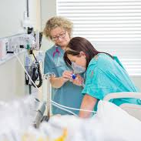
Exposure of midwives
In relation to its occupational impact, the use of scavenging can reduce the negative effects of Entonox for staff
recent evidence has shown that a double mask is a much more effective scavenging system in terms of staff exposure This tool is not in use.
‘Cracking’ technology has become available to break down nitrous oxide into its harmless constituents, nitrogen and oxygen. It has been shown to be effective at reducing both its environmental and occupational effects but is not yet in use

Slide 7
Control of Substances Hazardous to Health (COSHH) risk assessment March 2023
environmental ventilation
local extract ventilation (LEV)
rebreather facemasks with gas scavenging
staff positioning relative to exhaust N2O and the direction of ventilation flow
awareness of the COSHH risk assessment and its controls
training in the administration of gas and air
adherence to the mitigations
awareness and review of monitoring results.
https://www.england.nhs.uk/long-read/guidance-on-minimising-time-weighted-exposure-to-nitrous-oxide-in-healthcare-settings-in-england/

Slide 8
Psychoactive Substances Act 2016
Nitrous oxide is to become a Class C controlled substance,
It produces temporary psychoactive effects, including euphoria and uncontrollable laughter.
Under the act it is an offence to knowingly or recklessly supply nitrous oxide if it is likely to be used for its psychoactive effects.
In a government-commissioned N2O harms assessment, the Advisory Council on the Misuse of Drugs said that the Act “remains the appropriate drug legislation to tackle supply of nitrous oxide for non-legitimate use”, although it added that there is “a need for enforcement of the Psychoactive Substances Act 2016 to be supported by additional interventions designed to reduce health and social harms”.
In a written response 23/3/23 Chris Philp, minister for crime, policing, and fire, said that “the Government has decided to bring forward legislation to control nitrous oxide under the Misuse of Drugs Act 1971 as a Class C drug”. Philp cited the recent rise in reports of health and social harms as a result of the substance, as well as its widespread use and availability among young people.
We have taken the decision to go further, drawing on the stronger basis to take action against illegitimate supply that the Misuse of Drugs Act 1971 provides.”
It is not our desire to inhibit its use for legitimate purposes. We accept the ACMD’s recommendation to consult on legitimate uses to help inform how we continue to enable legitimate use within the legislation”.
The Pharmaceutical Journal, PJ, March 2023, Vol 310, No 7971;310(7971)::DOI:10.1211/PJ.2023.1.179805

Slide 9
Analgesic use in labour
when N2O is used as an analgesic, the efficacy of closed-circuit breathing apparatus is reduced through imperfect patient usage – most commonly, taking the rebreather mask/rebreather tube away from their mouth when exhaling.
If ventilation is insufficient:
provide clear instructions to patients on correct use of equipment being used, including exhaling into the rebreather mask or out through the mouthpiece
Consider staff positioning relative to exhaust N2O
turn gas and air off when not in use

Slide 10
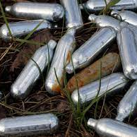
Long term or regular exposure
Memory loss
Vitamin B12 depletion
Ringing or buzzing in the ears
Incontinence
Numbness in the hands or feet
Limb spasms
Potential birth defects
Weakened immune system
Disruption to reproductive systems
Depression
Psychological dependence

Slide 11
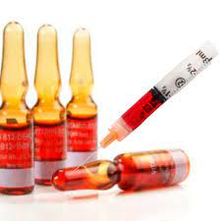
Vitamin B12 depletion
Can result in neurological disorders
vision problems.
memory loss.
pins and needles.
loss of physical co-ordination (ataxia), which can affect your whole body and cause difficulty speaking or walking.
Blood tests to staff who work on the maternity units to check if they have any vitamin B12 deficiency, as a precautionary measure, which can happen if exposed to nitrous oxide for a long period of time.
Vitamin B12 usually given IM as poorly absorbed orally in doses < 1000mcg/day

Slide 12
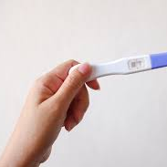
Reproductive Risk
Before occupational measures such as maximum exposure limits for nitrous oxide were introduced, medical professionals in dental and midwifery practices, operating theatres and ambulance transport were exposed to high levels of nitrous oxide.
Reported adverse reproduction effects included congenital anomalies, spontaneous abortion, and reduced fertility rates in females.
Non- legitimate users may be at risk if they exceed current health exposure limits.

Slide 13
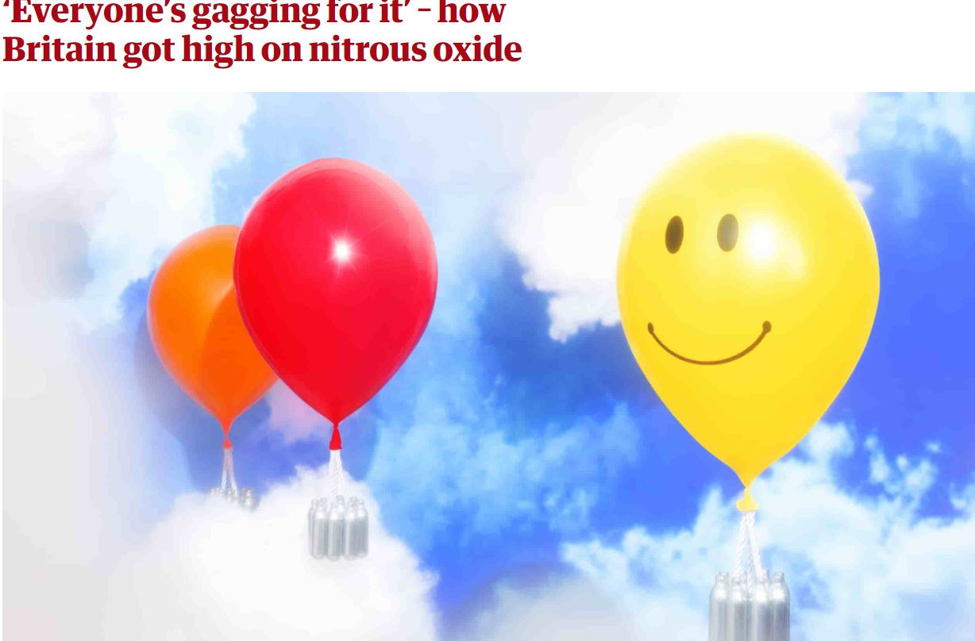
Recreational Use of Nitrous Oxide
Dramatically increasing 18-24 year olds second only to cannabis
Festival drug
Not illegal to use and cheap
Is illegal to possess with intent to supply for recreational purposes
Common adverse effects from using small amounts include dizziness, light-headedness, disorientation, headache, and a generalised tingling sensation. Nausea and fainting may also occur; as may temporary loss of co-ordination and balance
www.gov.uk/government/publications/nitrous-oxide-updated-harms-assessment/nitrous-oxide-updated-harms-assessment-accessible

Slide 14
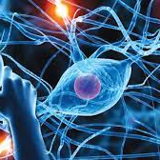
Regular/ long term recreational use
Initially, paraesthesia: abnormal sensations, typically tingling or pricking (‘pins and needles’), in the hands, arms, legs, or feet, and which can also occur in other parts of the body progressing to numbness
Damage may also involve nerves that are responsible for controlling muscles, leading to muscle weakness, loss of balance, and difficulty in walking.
Typically, the damage is at least partially reversible, especially if identified and treated early. Some individuals may be left with sensory or functional damage.
Rare cases of permanent paralysis have been reported and deaths where they place bags over head to inhale!

Slide 15
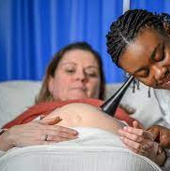
Conclusion
Be aware of potential risk of exposure in the workplace but don’t panic unless you regularly feel sick and dizzy after attending a birth.
Get a blood test if you are concerned
Risk assessment concern seems to be being led by high level recreational use but some midwives do have high levels
Discuss with the labouring mother what her analgesic options are and help her to relax and trust her body

